Slide 1
College Admission Analysis Python Project
Instructor: James Topor
Team member: Randy Xia, Qihua Zhu

Slide 2
Why this Project?
How could we get in this school?
Admission Rate?
or SAT Score?

Slide 3
What is Our Project?
Authoritative data from Government
1,200 rows of vailed data of each school
Data cleaning and transformation
Analyze and build a predictive model

Slide 4
Some Important Data
College Scorecard Data (CSV)
Overall average SAT score
The average faculty salary
Total enrollment that fall
Type(Public, Private Profit, Private Non-Profit )
Tuition fee( in & out-of-state)
Median & Mean family income of students
States Population & Income Data (API)
Average Income each states
Population each states

Slide 5
Assumption
People paying more for a lower admission rate
Higher average income
Higher tuition fee

Slide 6
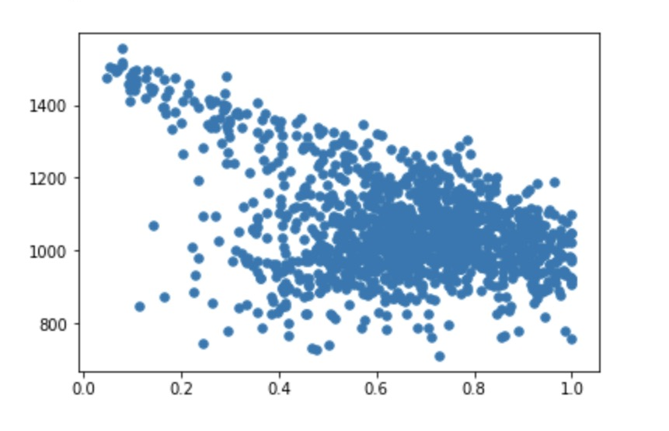
What effects Admission Rate(EDA)?
Strong Relationship
SAT score, Gender, and Type(Public, Private Profit, Private Non-Profit )
Average Overall SAT Score
Admission Rate

Slide 7
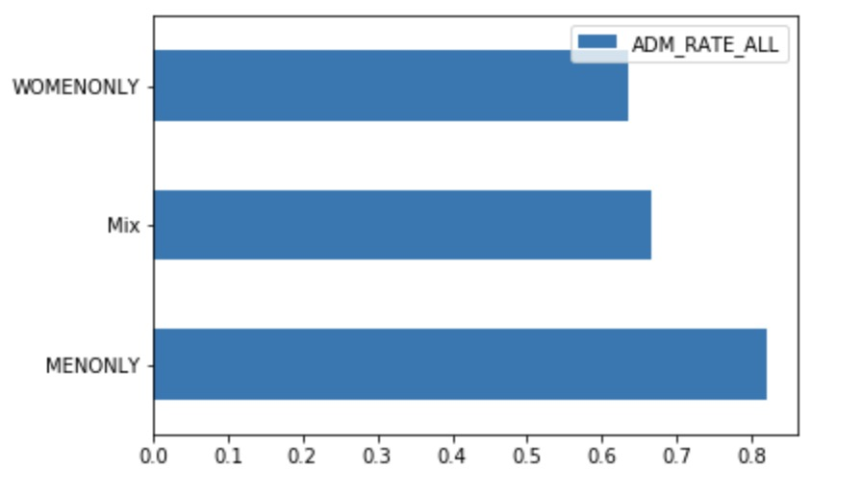
What effects Admission Rate(EDA)?
Strong Relationship
SAT score, Gender, and Type(Public, Private Profit, Private Non-Profit )

Slide 8
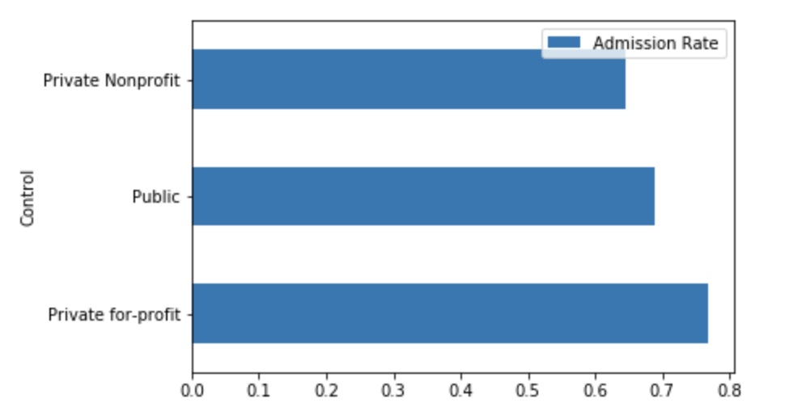
What effects Admission Rate(EDA)?
Strong Relationship
SAT score, Gender, and Type(Public, Private Profit, Private Non-Profit )

Slide 9
What effects Admission Rate(EDA)?
No Clear Relationship
Population of each State
Weak Relationship
Tuitions, Pell Grant(%), and Student Loans(%)

Slide 10
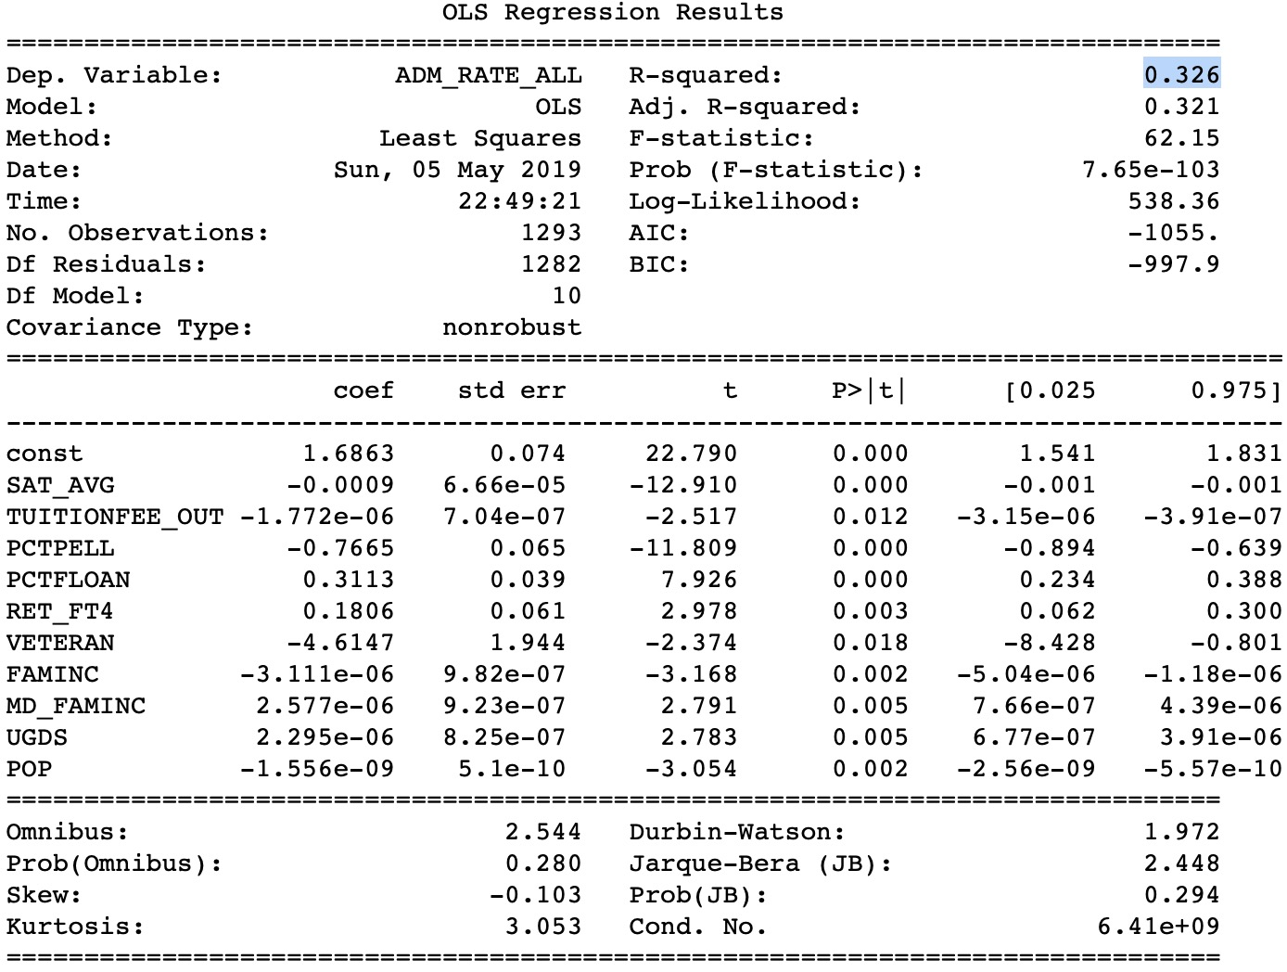
What effects Admission Rate?

Slide 11
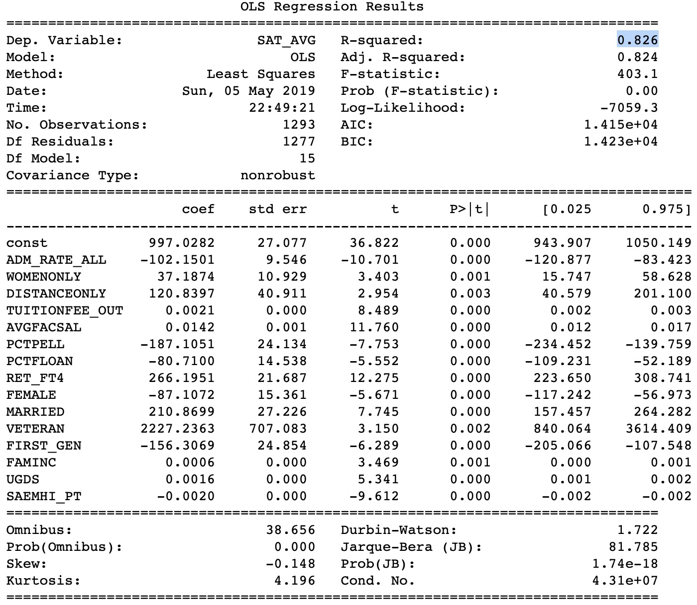
Importance of SAT score

Slide 12
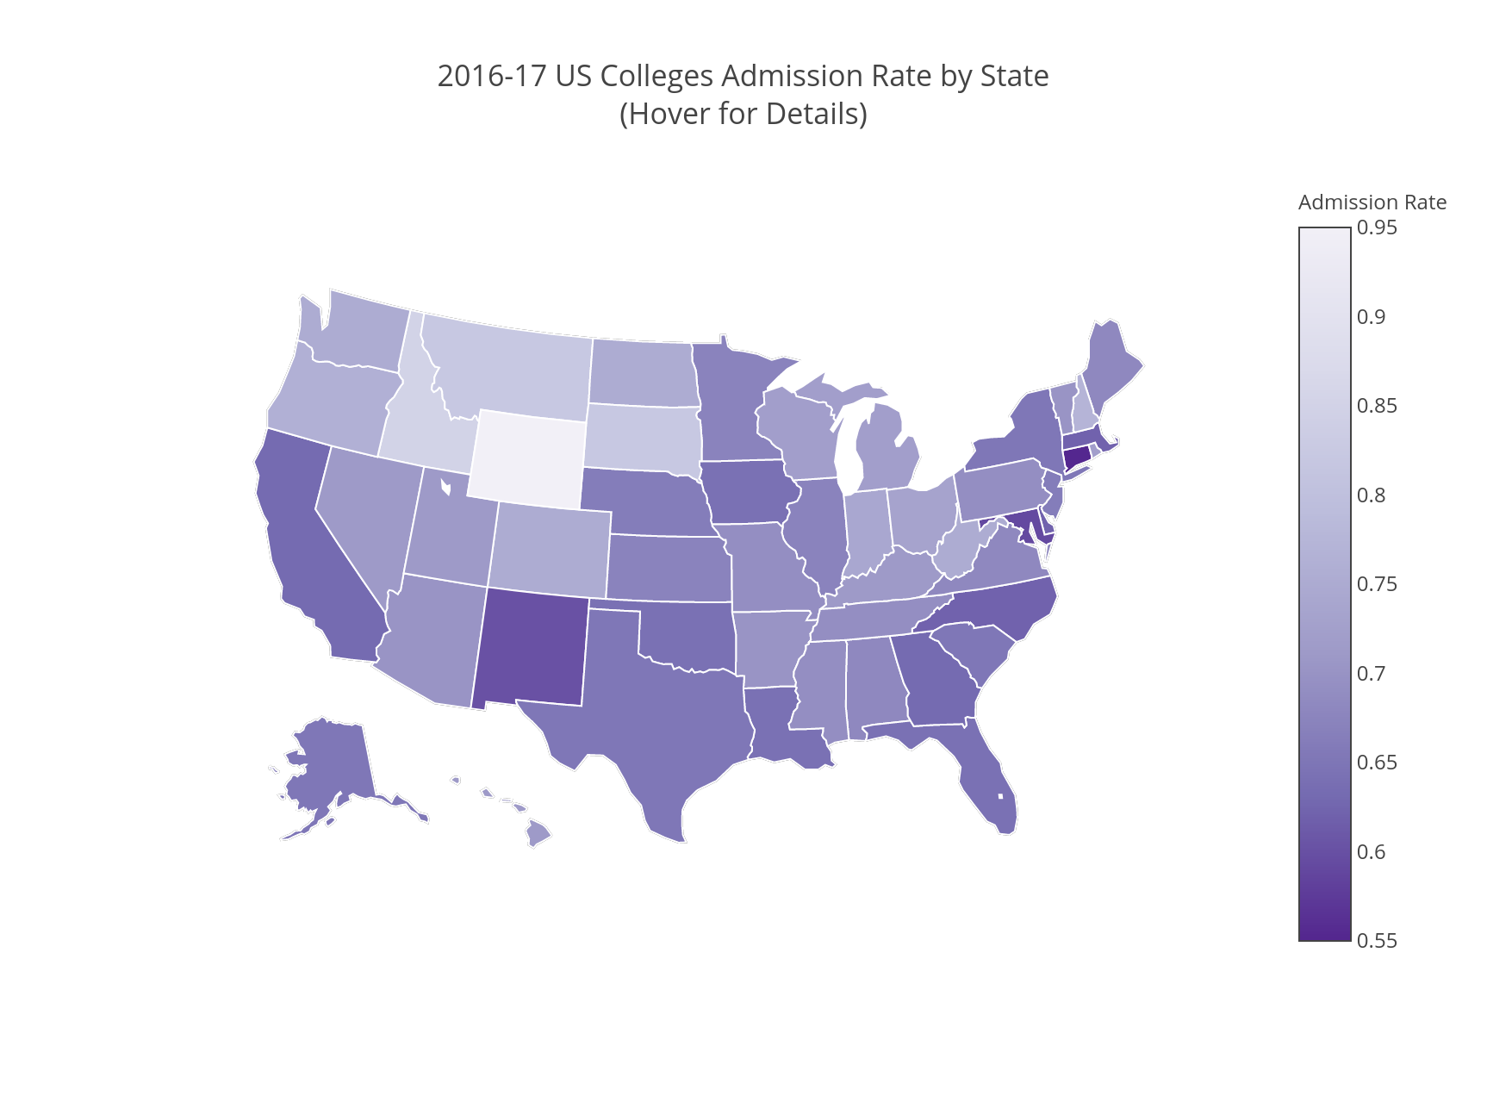

Slide 14

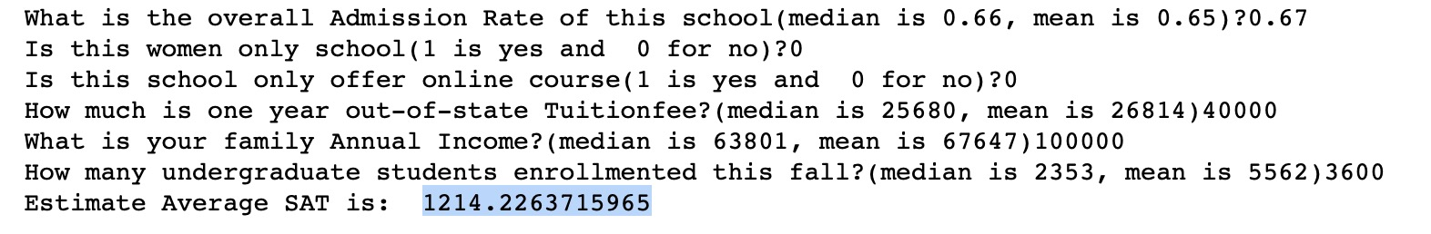
A Chatbot for SAT

Slide 15
Challenges Encountered
Understanding and cleaning the huge dataset
Hardship in Reading and Using the API
Rendering Map in GitHub via Plot.ly
How to present the result in a straightforward way

Slide 16
Conclusion
Admission Rate is not a good value to observed
Average Overall SAT score is a good value to observed

Slide 17
Q&A

